Slide 1
Mid-semester feedback
Things to improve in the course:
Things that you are finding difficult:
Ways to self-improve:

Slide 2
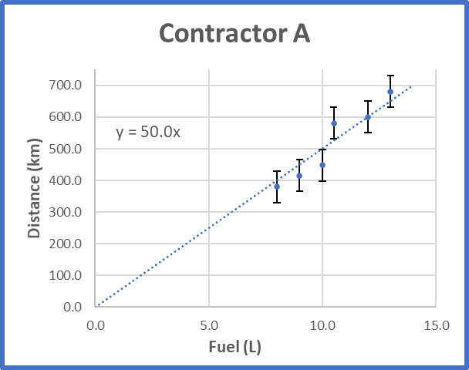
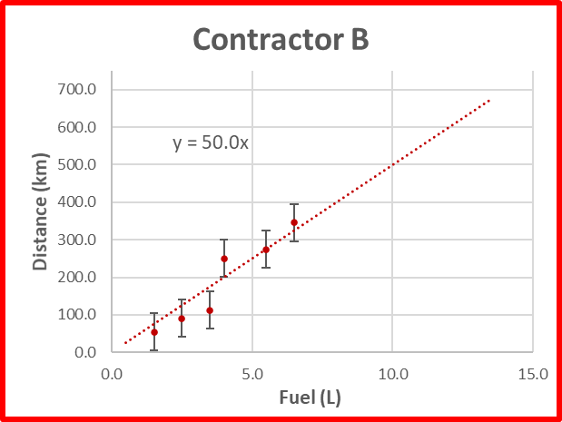
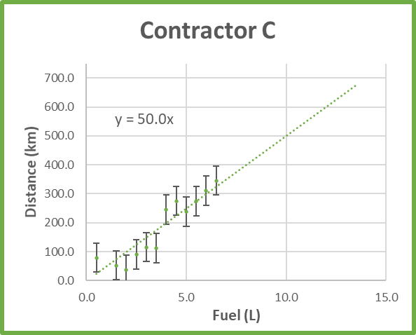
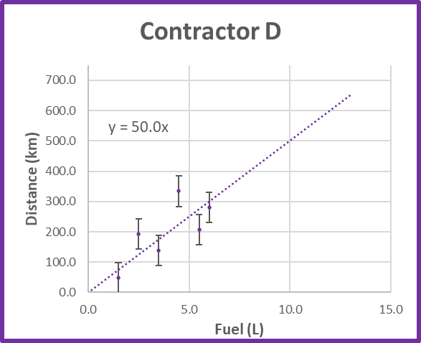
Prelab 4
Fuel (L) | Distance (km) | δD (km)
8.0 | 379.6 | 50.0
9.0 | 415.7 | 50.0
10.0 | 448.5 | 50.0
10.5 | 581.2 | 50.0
12.0 | 599.9 | 50.0
13.0 | 680.7 | 50.0
Fuel (L) | Distance (km) | δD (km)
1.5 | 54.6 | 50.0
2.5 | 90.7 | 50.0
3.5 | 112.5 | 50.0
4.0 | 250.2 | 50.0
5.5 | 274.9 | 50.0
6.5 | 345.7 | 50.0
Fuel (L) | Distance (km) | δD (km)
0.5 | 79.3 | 50.0
1.5 | 52.6 | 50.0
2.0 | 37.5 | 50.0
2.5 | 90.7 | 50.0
3.0 | 115.7 | 50.0
3.5 | 112.5 | 50.0
4.0 | 245.2 | 50.0
4.5 | 275.2 | 50.0
5.0 | 238.5 | 50.0
5.5 | 274.9 | 50.0
6.0 | 310.7 | 50.0
6.5 | 345.7 | 50.0
Fuel (L) | Distance (km) | δD (km)
1.5 | 47.5 | 50.0
2.5 | 192.3 | 50.0
3.5 | 137.8 | 50.0
4.5 | 334.0 | 50.0
5.5 | 207.4 | 50.0
6.0 | 281.1 | 50.0
Which contractor has the best estimate for the fuel efficiency?

Slide 3
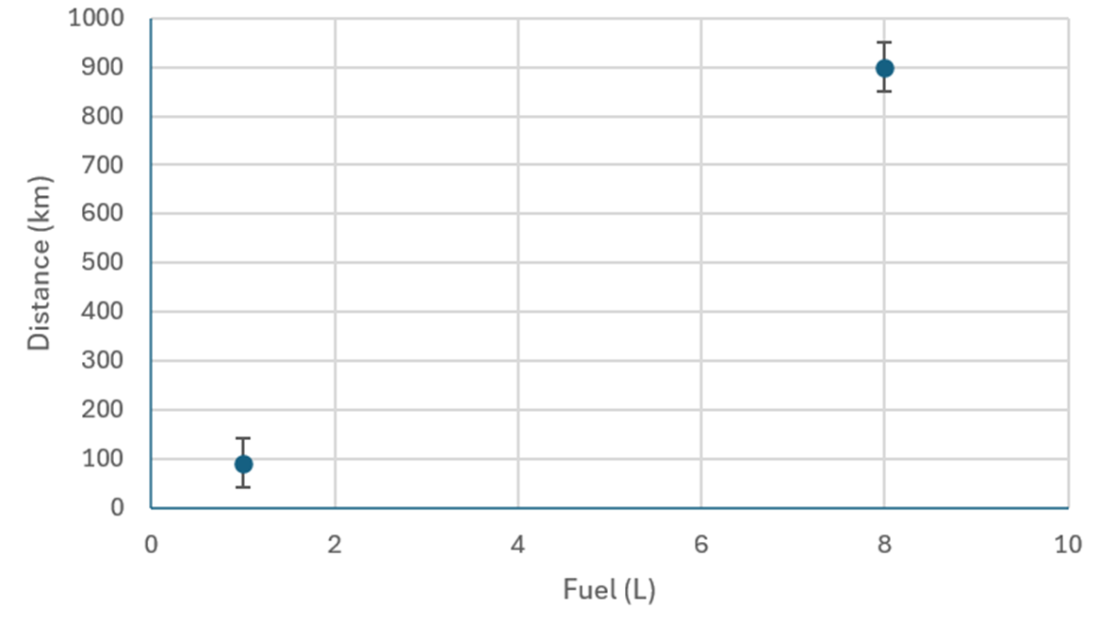
Why do we need a weighted average?
What if some points are “more important” than others?
Which of these points better constrains the slope?

Slide 4
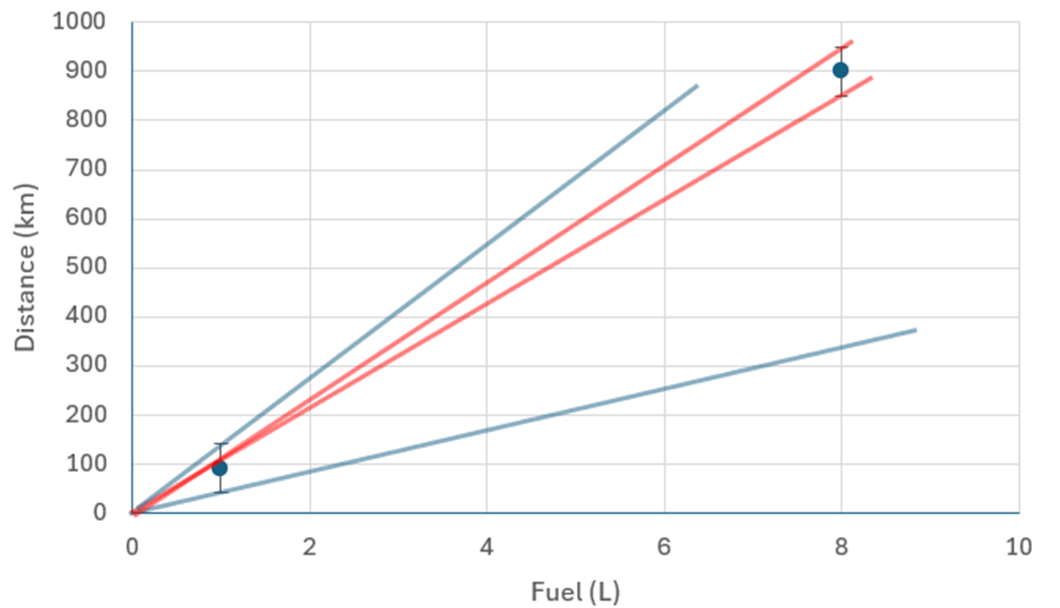
Why do we need a weighted average?
What if some points are “more important” than others?
Which of these points better constrains the slope?
Points that are farther away better constrain the slope!

Slide 5
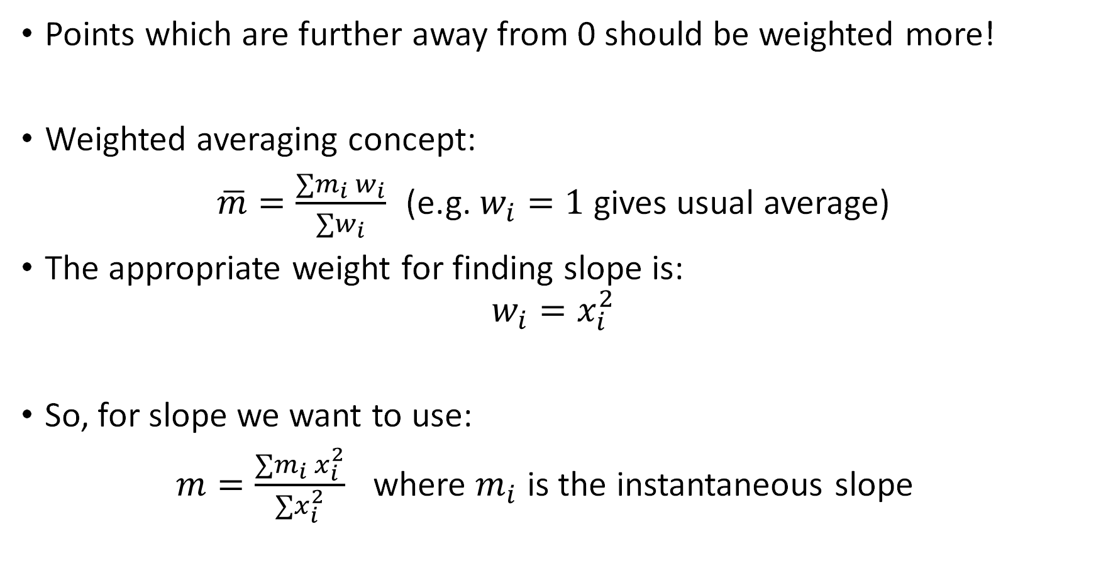
Calculating weighted average/slope
Points which are further away from 0 should be weighted more!
Weighted averaging concept:
$\overline{m}=\frac{∑m_{i} w_{i}}{∑w_{i}}$ (e.g. $w_{i}=1$ gives usual average)
The appropriate weight for finding slope is:
$$w_{i}=x_{i}^{2}$$
So, for slope we want to use:
$m=\frac{∑m_{i} x_{i}^{2}}{∑x_{i}^{2}}$ where $m_{i}$ is the instantaneous slope

Slide 6
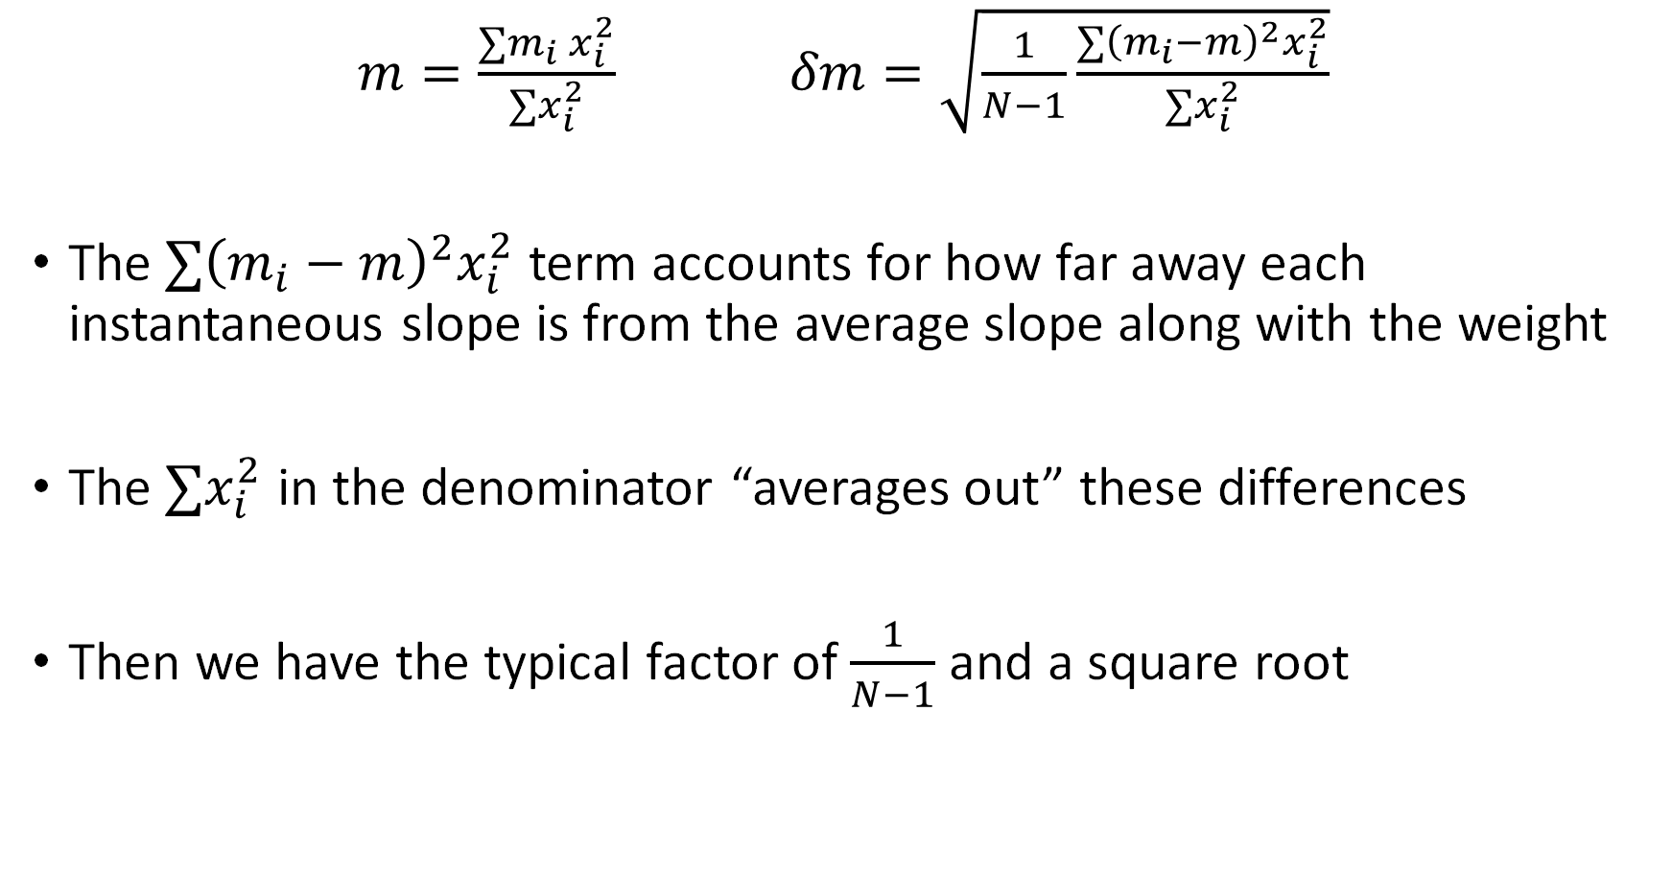
Uncertainty in weighted slope
$m=\frac{∑m_{i} x_{i}^{2}}{∑x_{i}^{2}}$ $δm=\sqrt{\frac{1}{N−1}\frac{∑{\left(m_{i}−m\right)}^{2}x_{i}^{2}}{∑x_{i}^{2}}}$
The $∑{\left(m_{i}−m\right)}^{2}x_{i}^{2}$ term accounts for how far away each instantaneous slope is from the average slope along with the weight
The $∑x_{i}^{2}$ in the denominator “averages out” these differences
Then we have the typical factor of $\frac{1}{N−1}$ and a square root

Slide 7
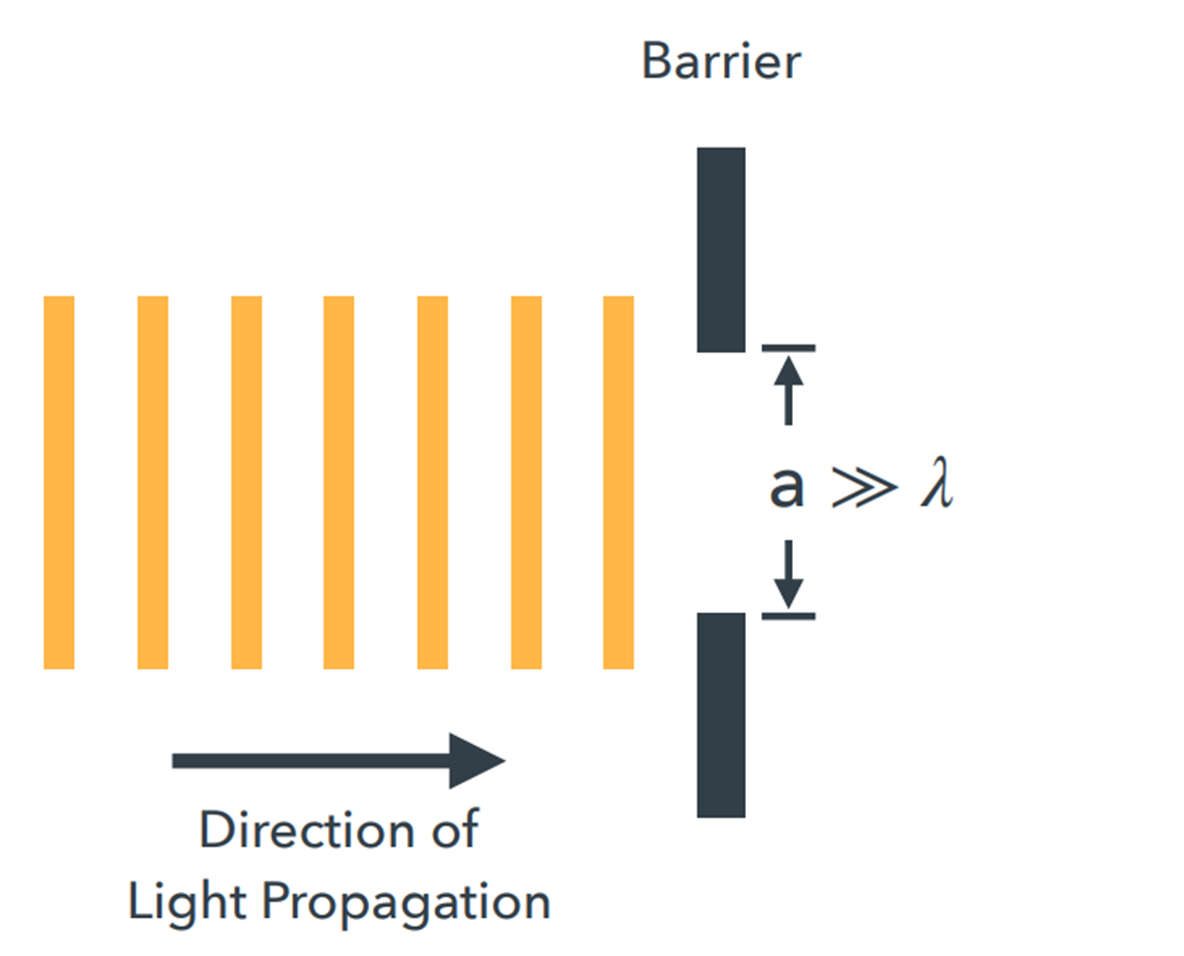
Diffraction and Interference
What if we have a large slit?

Slide 8
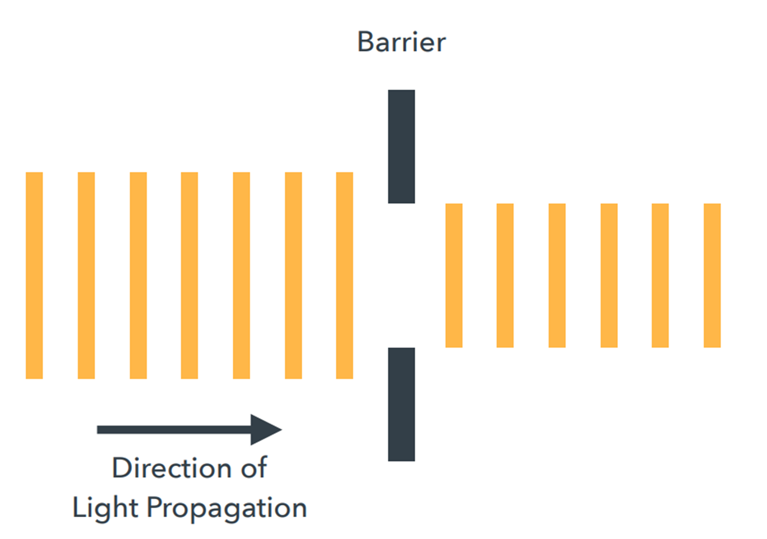
Diffraction and Interference
Light passes through as expected

Slide 9
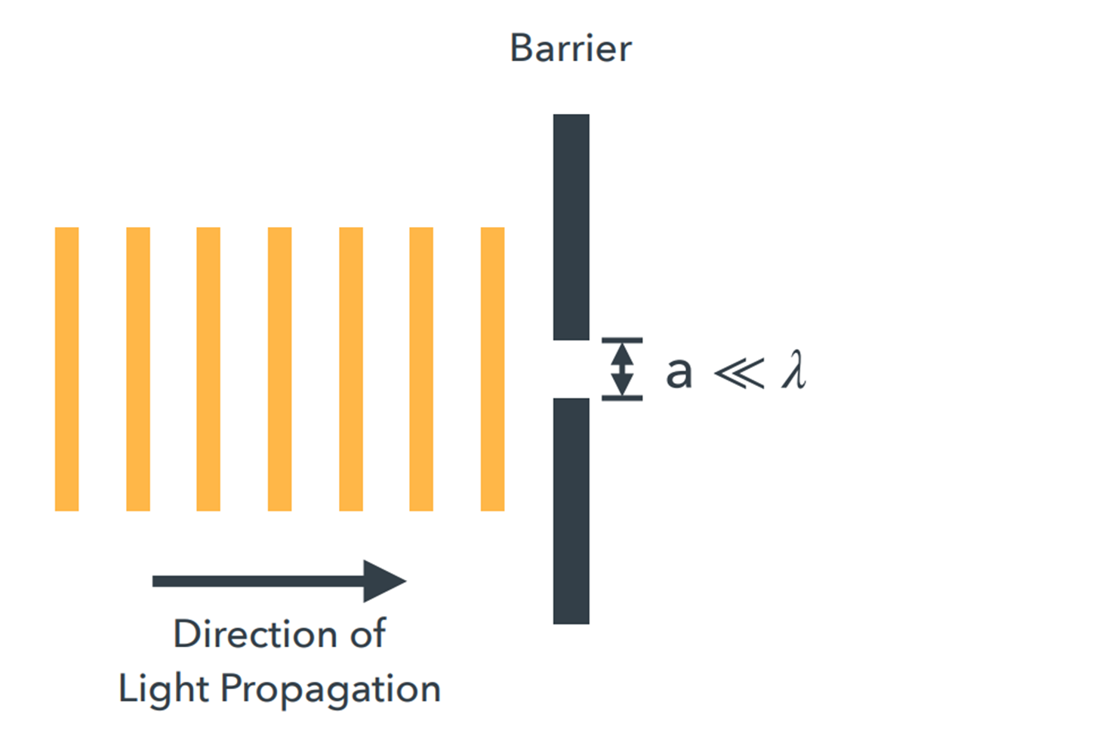
Diffraction and Interference
What if we have a small slit?

Slide 10
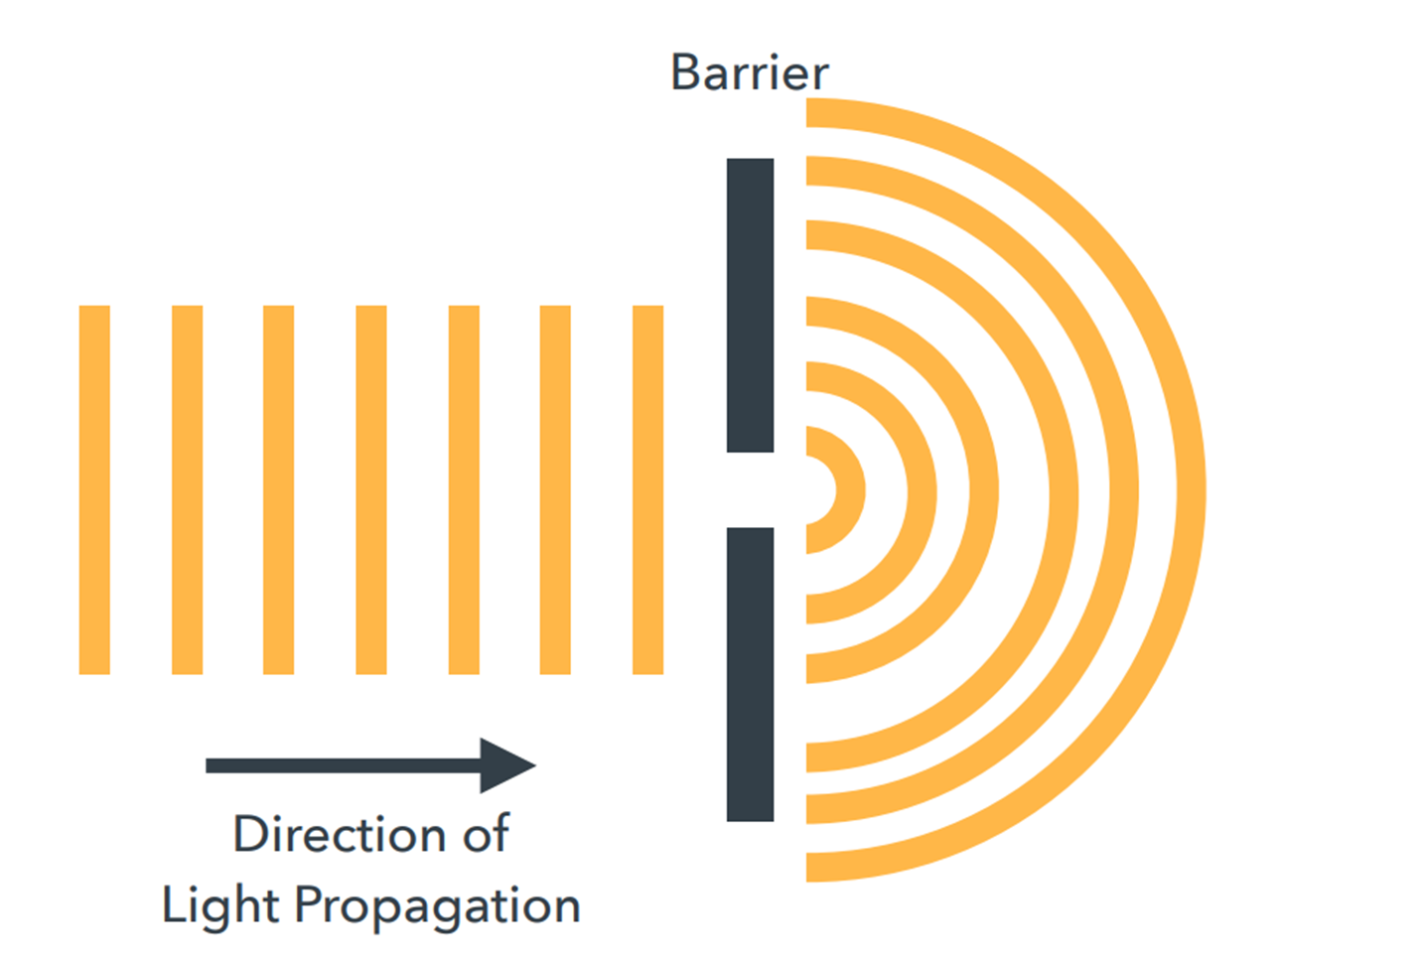
Diffraction and Interference
We get a diffraction pattern!

Slide 11
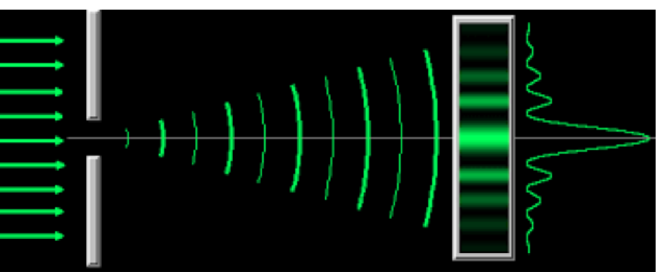

What does diffraction look like?
$$Δy_{dark}$$

Slide 12
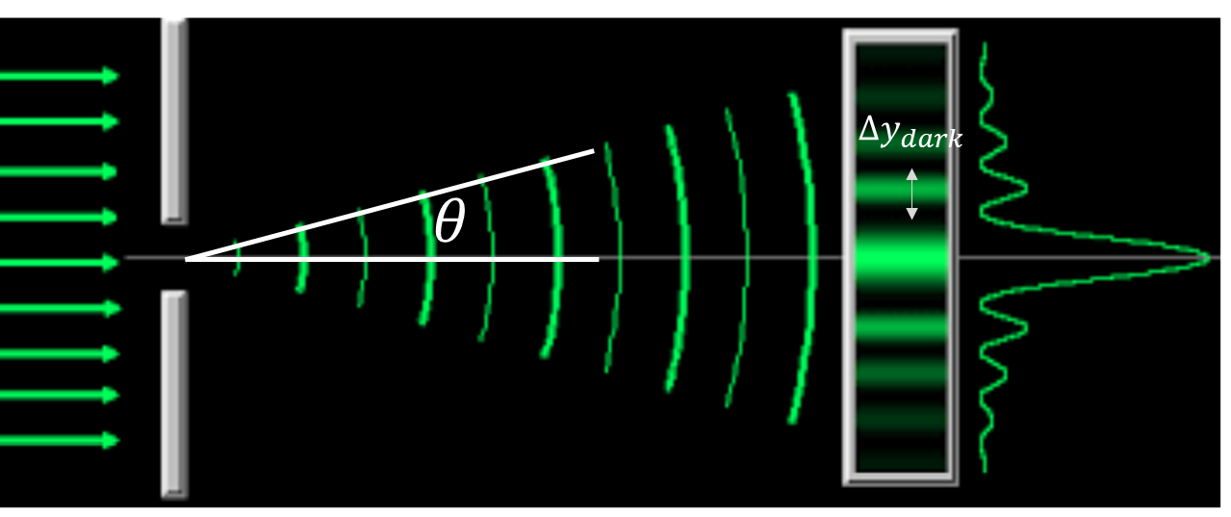


Diffraction and Interference
Single slit interference: $a\sin{θ}=mλ$
$$Δy_{dark}$$

Slide 13

Diffraction and Interference
Single slit interference: $a\sin{θ}=mλ$
Using small angle approx: $y=m\frac{λL}{a}$
If we care about subsequent fringes: $Δy_{dark}=\frac{λL}{a}$
$$Δy_{dark}$$

Slide 14
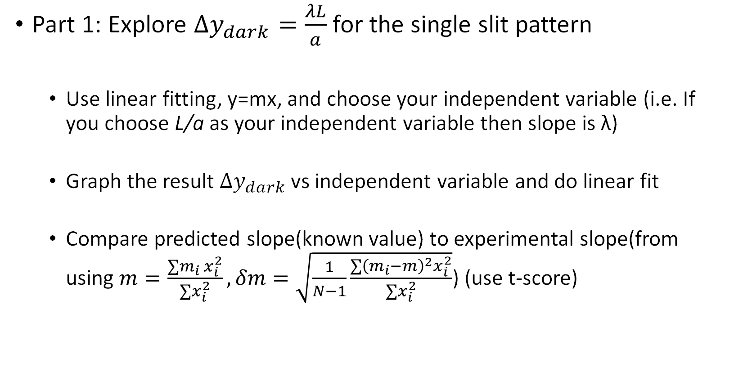
Lab 4
Part 1: Explore $Δy_{dark}=\frac{λL}{a}$ for the single slit pattern
Use linear fitting, y=mx, and choose your independent variable (i.e. If you choose L/a as your independent variable then slope is λ)
Graph the result $Δy_{dark}$ vs independent variable and do linear fit
Compare predicted slope(known value) to experimental slope(from using $m=\frac{∑m_{i} x_{i}^{2}}{∑x_{i}^{2}},δm=\sqrt{\frac{1}{N−1}\frac{∑{\left(m_{i}−m\right)}^{2}x_{i}^{2}}{∑x_{i}^{2}}}$) (use t-score)

Slide 15

Lab 4
Part 2:
Explore same equation using 2 different patterns
Circular aperture + another
Choose what to define as $Δy_{dark}$

